Slide 1

Health & Human Rights

Slide 2
Overview & Outcomes
Session Aims:
  Provide an overview of course learning outcomes, course content, and topics
  Provide an overview of assignments and expectations
  Introduction to Normative Analysis
  Opportunity for questions and discussion

Slide 3
Course Description
Provides an introduction to international law, human rights, and the right to health. Explores the relationship between health and human rights, and how human rights provides a form of social machinery to improve well-being and promote social justice. Also explores the benefits and challenges of taking a human rights-based approach in global health through investigating its application in different case studies.

Slide 4
Assignment 1
You need to decide what will be the focus of your HRIA.
This assignment will help you develop the rationale and focus of your HRIA.
Starting thinking now about an issue area within global health and a relevant activity or policy that you can assess its impact with respect to human rights.
Focus on an area/issue that you’re familiar with or want to develop greater knowledge about.

Slide 5
Assignment 1
According to Gostin and Mann (1994: 58): “All governmental policies in general, and health policies in particular, have the potential to burden human rights to a greater or lesser degree, whether by restricting freedoms, discriminating against individual or population groups, or other mechanisms. While the protection of public health may in some cases outweigh concerns relating to human rights burdens, there are many instances where human rights are needlessly infringed. ... a Human Rights Impact Assessment... allows policy makers and human rights advocates to identify potential human rights burdens posed by public health policies and suggests strategies for ameliorating those burdens.”

Slide 6
Assignment 1
The purpose of the first assignment is for you to select and justify the topic of focus for your HRIA. You will need to select one government policy or activity that:
Either is an explicit health policy/activity or a policy/activity that has direct bearing on health
Is a topic that is relevant to global health
Can be a policy or activity at the local, national, or international level

Slide 7
Assignment 1
You should structure your assignment around answering the following questions:
What is the government policy or activity you have selected? How long has it been in effect?
What level or levels of government is the source of this policy or activity?
Why does this policy or activity relate to global health?
Why does the policy/activity and global health topic you have selected make a good candidate for a HRIA?

Slide 8

Question
Is a hot dog a sandwich? If so, why? If not, why not?
What method would you use to answer?

Slide 9
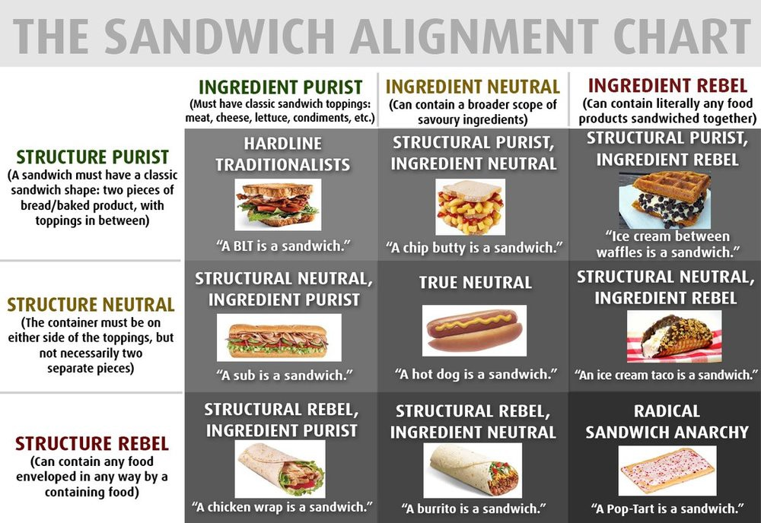

Slide 11
Empirical Claims
Empirical = based on, concerned with, or verifiable by observation or experience.
Empirical research methods: quantitative and qualitative
Examples of empirical claims:
  I ate two hot dogs for breakfast this morning
  I eat hot dogs only with mustard
  Hot dogs are high in sodium
  Over 950 million hot dogs were sold in Canada last year

Slide 12

Conceptual Claims
Conceptual = based on, concerned with, or verifiable by theory or logic.
Focus on concepts or ideas instead of the senses.
Conceptual questions cannot be answered simply by giving empirical facts or information.
Answers are provided by reasons, argumentation, and analysis.

Slide 13

Descriptive Claims
Descriptive claims = empirical claims.
Descriptive claims are claims about how the world is.
Descriptive claims give facts that can be tested or verified using empirical methods.

Slide 14
Normative Claims
Conceptual claims Theoretical Claims
Normative Claims
Concepts can be abstract or concrete
Normative claims are claims about how the world should be.
Normative claims involve values that can be tested or verified using normative methods.

Slide 15
Norms
Norms can be reflected in principles, standards, rules, and values.
They set out “correctness conditions” – typically for action.
Norms seek to guide or prescribe our actions – point out what we have reason to do.

Slide 16
Reasons
Reasons are considerations that count in favour (or against) acting or believing.
Normative reasons for action are considerations that justify action (in action).
Motivational reasons are considerations that explain or cause why someone acted (or failed to act).
N.B. Not all motivational reasons will be normative reasons!
Motivational reasons are descriptive and normative reasons are normative.

Slide 17
Normativity
Normativity can be divided into two broad areas: deontic and evaluative.
Deontic claims are claims about what is right/wrong, just/unjust, required/prohibited.
Evaluative claims are claims about what is good, bad, better than.
What would be a deontic claim and an evaluative claim about a hot dog?

